Slide 1
Recycle: your Mind
Chuck Nwerke, Juan Guerra.
Johnson Mei, Daniel Martin

Slide 2
Green Campus
Educates player on proper disposal
Reducing materials that go into waste
Compost materials assist farming
Reduce, Reuse, Recycle

Slide 3
Reduce
Reducing waste is simple: use less.
Reducing waste reduced demand for processed plastics and non renewable materials.

Slide 4
Reuse
Reusing materials prevents waste from becoming waste, and using enough creativity you can prevent something from becoming waste in general

Slide 5
But Recycle?
In a few short years we have gone from a blue novelty bin in the corner to being one of the largest recycling states in the country.
But how many of us know WHAT to recycle?

Slide 6

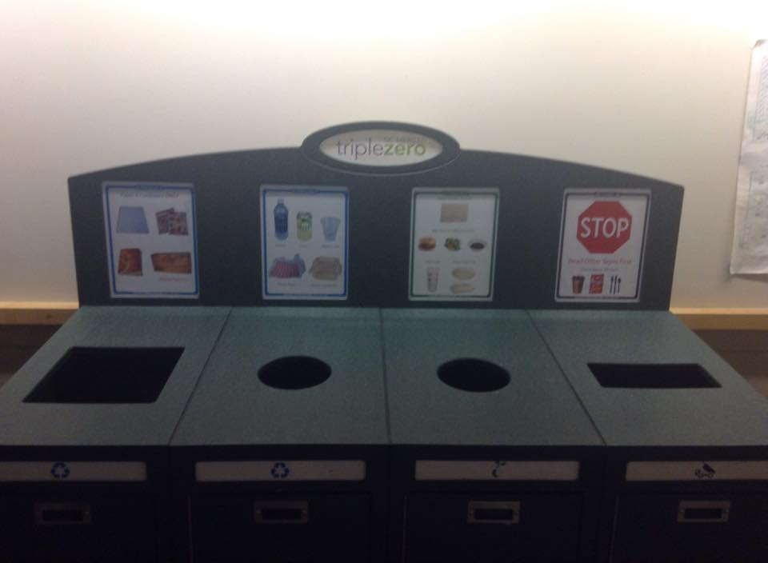

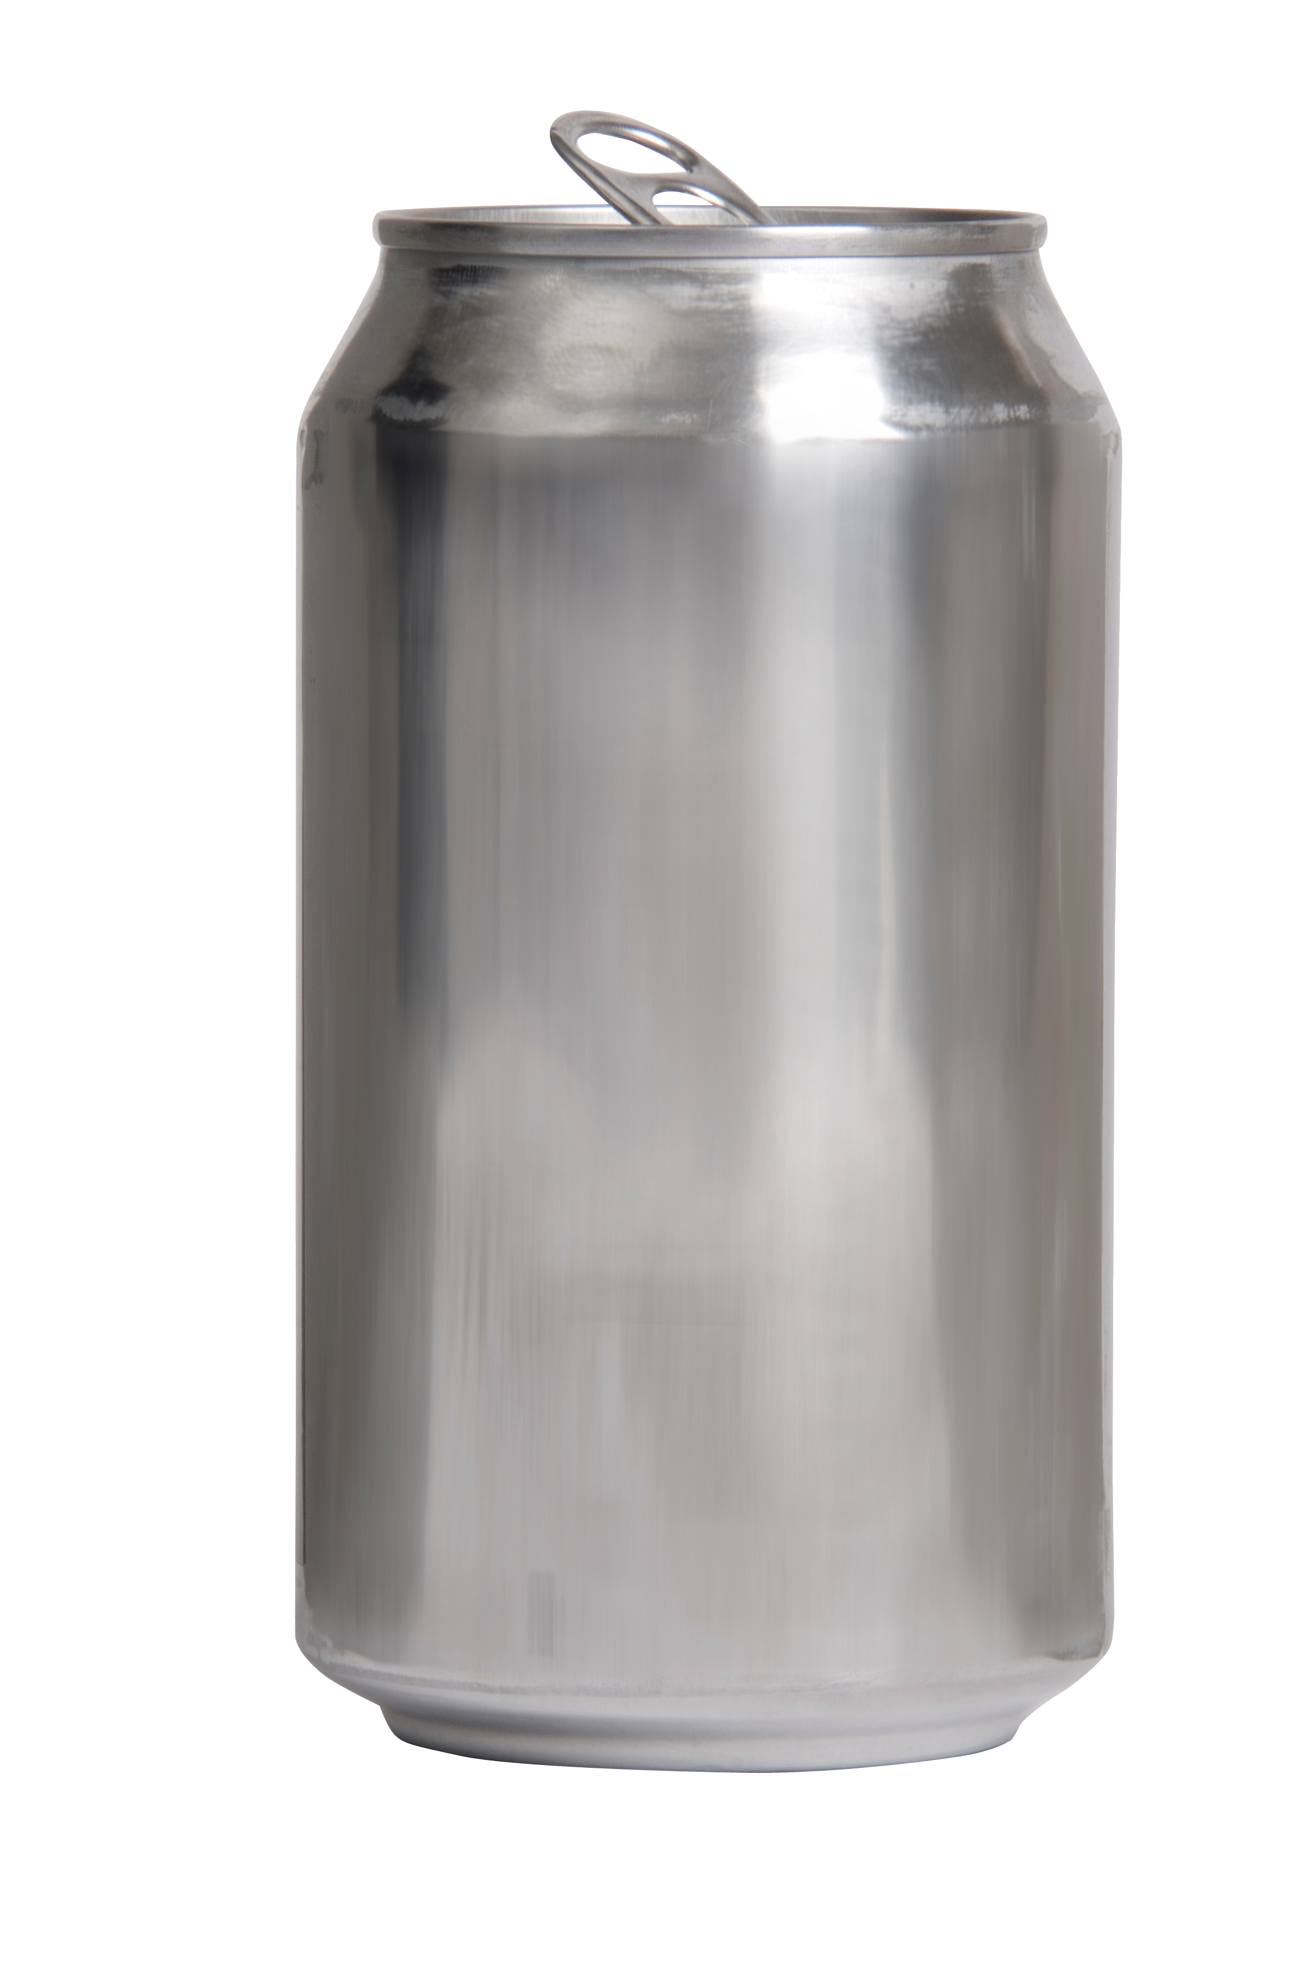
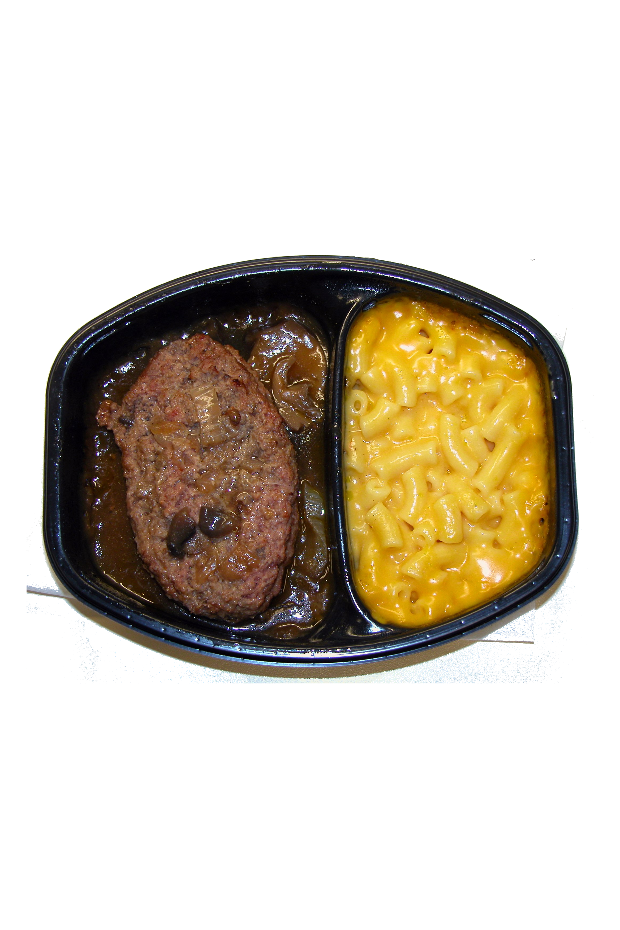

Slide 7
Recycle: your Mind
We aim to educate other about what materials are recyclable, in a fun and challenging way.
Recycle: your Mind quizzes users a la LogoQuiz and Trivia Crack, and challenges users to compete for high scores, whilst providing statistics about recycling and fun facts about projects

Slide 8
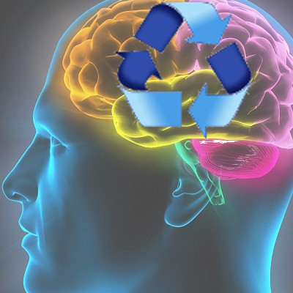
Prepare to

